Slide 1
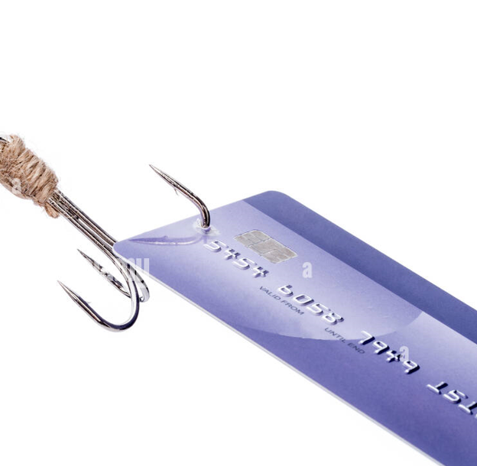
Predicting Credit Card Fraud

Slide 2
Section 1: Quantify the problem with credit card fraud.
There were 1,686,121 reports of identity theft in 2021.
Government documents or benefits fraud was the most common type of identity theft in 2021.
Those aged 30 to 39 reported the most cases of identity theft.
Rhode Island, Kansas, and Illinois were the top three states for identity theft per capita.
Credit card fraud declined by 1% from 2020 levels, with 389,845 reports.
There were 1,862 data breaches in 2021, a 68% increase from 2020 and an all-time high.
The number of people affected by data breaches decreased from 2020, with 293,927,708 people impacted in 2021.
losses of $56 billion in 2021
https://www.fool.com/the-ascent/research/identity-theft-credit-card-fraud-statistics/

Slide 3
Section 2: Visualizations to depict some of these quantifications
Notes for talking points on each viz in Waynette’s workbooks
Visit the html page(s) as to show viz’s

Slide 4
Section 3: Visualization to show locations of these issues
Notes for talking points on Ariana’s visualizations
Visit tableau public for display of viz’s

Slide 5
Section 4: Prevention
Talk about preventing credit card fraud: notes here
https://diamondvalleyfcu.org/blog/5-ways-avoid-credit-card-fraud
Can add a html page for this if desired

Slide 6
Section 5: Bank Early Detection
Talk about Aaron’s Model for the prediction of fraudulent transactions
Notes for the model here
Visit html page for screenshots of finished model

Slide 7
Section 6: Site Sources here(see previous slides to fill this in)

Slide 8

Questions

